Slide 1
It’s All About Partnerships

Slide 2
NWS Vision

Slide 3
The Need for Ambassadors for a Weather Ready Nation
In 2012, the U.S. Congress directed the National Weather Service to contract with an independent organization to evaluate NWS Operations
The National Academy of Public Administration spent 7 months assessing the NWS operations and structure and came up with 15 recommendations
http://www.napawash.org/2013/1455-forecast-for-the-future-national-weather-service.html

Slide 4
It’s All About Partnerships
Government
Emergency Management
Academia
Private Sector
Broadcast Media
Social Science

Slide 5
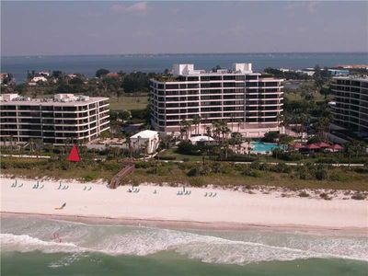
Who Can Become a WRN Ambassador? http://noaa.gov/wrn
Any organization across all levels of government
Businesses large and small
TV, Radio, and Print media
Non-profit and non-governmental organizations
Academia
The Sanctuary at Longboat Key Club Community Assoc., Inc

Slide 6
WRN Ambassador in West Central Florida
Tampa Bay Regional Planning Council The Sanctuary at Longboat Key Club Community Spring Hill Amateur Radio Club WUSF Public Radio Polk County Emergency Management Manatee County Emergency Management Suncoast News Network (SSN 6) | West Central Florida American Meteorological Society The Lakeland Center WRMD Telemundo Tampa Compass Star Consulting LLC Fox 13 WTVT-TV Tampa Bay Sarasota, FL
http://weather.gov/tampa/?n=wrn

Slide 7
Benefits of becoming an Ambassador
Permission to use the WRN logo allows organizations to take ownership
Use the local NWS office as a resource to enhance weather safety plans
Periodic emails will provide information such as links to newly posted outreach material on relevant hazards and updates experimental /new NOAA products, services, or data.
Ambassadors are part of a unified effort to increase consistency in messaging

Slide 8
NWS Tampa Bay Social Media
http://weather.gov/tampabay
@NWSTampaBay
http://fb.com/NWSTampaBay
http://www.youtube.com/NWSTampa

